Slide 1
12.2 – Conditional Probability

Slide 2

Conditional Probability
Conditional Probability contains a condition that may limit the sample space for an event.
You can write a conditional probability using the notation
- This reads “the probability of event B, given event A”

Slide 3
Conditional Probability
The table shows the results of a class survey.
Find P(own a pet | female)
Do you own a pet?
yes no
female 8 6
male 5 7
14 females; 13 males
The condition female limits the sample space to 14 possible outcomes.
Of the 14 females, 8 own a pet.
8
14
Therefore, P(own a pet | female) equals .

Slide 4
Conditional Probability
The table shows the results of a class survey.
Find P(wash the dishes | male)
Did you wash the dishes last night?
yes no
female 7 6
male 7 8
13 females; 15 males
The condition male limits the sample space to 15 possible outcomes.
Of the 15 males, 7 did the dishes.
Therefore, P(wash the dishes | male)
7
15

Slide 5

Let’s Try One
Using the data in the table, find the probability that a sample of not recycled waste was plastic. P(plastic | non-recycled)
The given condition limits the
sample space to non-recycled
waste.
Material Recycled Not Recycled
Paper 34.9 48.9
Metal 6.5 10.1
Glass 2.9 9.1
Plastic 1.1 20.4
Other 15.3 67.8
A favorable outcome is
non-recycled plastic.
P(plastic | non-recycled) =
20.4
48.9 + 10.1 + 9.1 + 20.4 + 67.8
=
20.4
156.3
0.13
The probability that the non-recycled waste was plastic is about 13%.

Slide 6
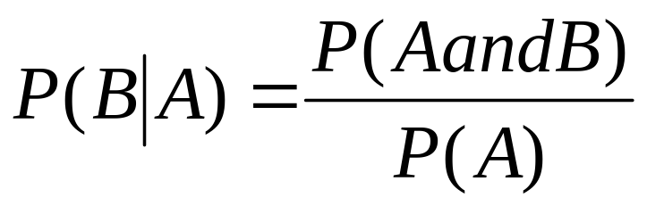
Conditional Probability Formula
For any two events A and B from a sample space with P(A) does not equal zero

Slide 7
Conditional Probability
Researchers asked people who exercise regularly whether they jog or walk. Fifty-eight percent of the respondents were male. Twenty percent of all respondents were males who said they jog. Find the probability that a male respondent jogs.
Relate: P( male ) = 58%
P( male and jogs ) = 20%
Define: Let A = male.
Let B = jogs.
Write: P( A | B ) =
P( A and B )
P( A )
0.2
0.58
= Substitute 0.2 for P(A and B) and 0.58 for P(A).
0.344 Simplify.
The probability that a male respondent jogs is about 34%.

Slide 8
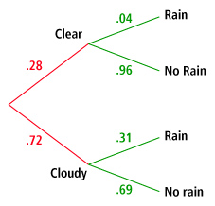
Using Tree Diagrams
Jim created the tree diagram
after examining years of weather
observations in his hometown. The
diagram shows the probability of
whether a day will begin clear or
cloudy, and then the probability
of rain on days that begin clear
and cloudy.
a. Find the probability that a day will start out clear, and then will rain.
The path containing clear and rain represents days that start out clear
and then will rain.
P(clear and rain) = P(rain | clear) • P(clear)
= 0.04 • 0.28
= 0.011
The probability that a day will start out clear and then rain is about 1%.

Slide 9
Conditional Probability
(continued)
b. Find the probability that it will
not rain on any given day.
The paths containing clear and no rain and cloudy and no rain both represent
a day when it will not rain. Find the probability for both paths and add them.
P(clear and no rain) + P(cloudy and no rain) =
P(clear) • P(no rain | clear) + P(cloudy) • P(no rain | cloudy)
= 0.28(.96) + .72(.69)
= 0.7656
The probability that it will not rain on any given day is about 77%.

Slide 10
Let’s Try One
Pg 688
A survey of Pleasanton Teenagers was given.
  60% of the responders have 1 sibling; 20% have 2 or more siblings
  Of the responders with 0 siblings, 90% have their own room
  Of the respondents with 1 sibling, 20% do not have their own room
  Of the respondents with 2 siblings, 50% have their own room
  Create a tree diagram and determine
  P(own room | 0 siblings)
  P(share room | 1 sibling)

Slide 11
  60% of the responders have 1 sibling; 20% have 2 or more siblings
  Of the responders with no siblings, 90% have their own room
  Of the respondents with 1 sibling, 20% do not have their own room
  Of the respondents with 2 siblings, 50% have their own room
  Create a tree diagram and determine
  P(own room | 0 siblings)
  P(share room | 1 sibling)

